Slide 1
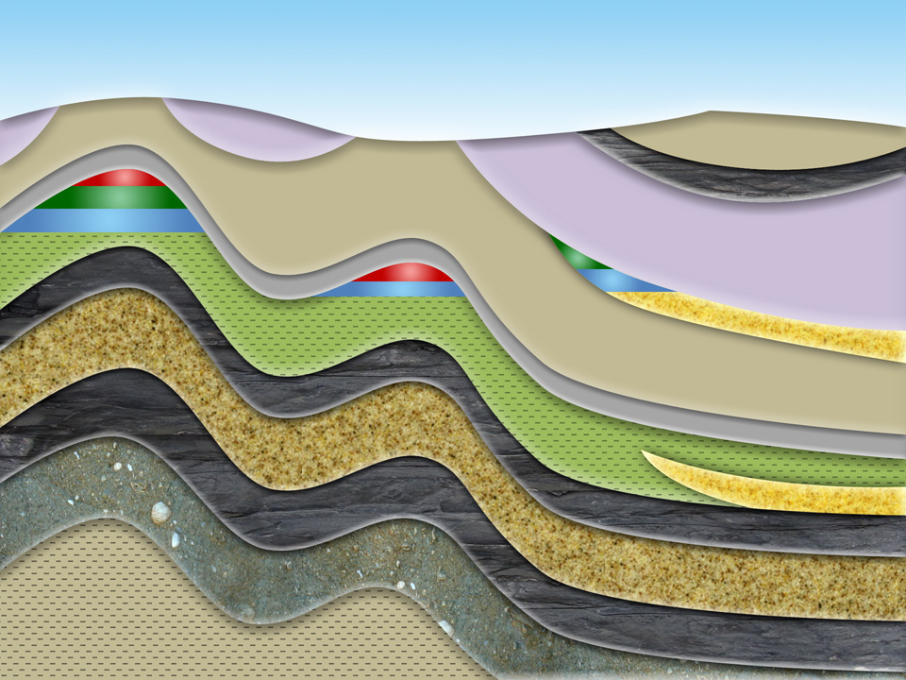

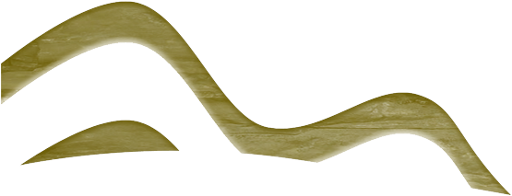
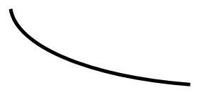

Machine Learning SweetSpot Identification WorkFlow for Unconventional Plays
Detlef Hohl, Larry Lu, Jan Limbeck, Mauricio Araya (Computation& Modeling, PTI/RP)
Mingqi Wu (Stats&Chemo, PTD/TASE), Franz Kiraly (University College of London)
Notes:
1

Slide 2
Outline
Overview of the Project
Data integration and interpolation
Predictive modeling
Future work

Slide 3
1.0
PROJECT overview

Slide 4
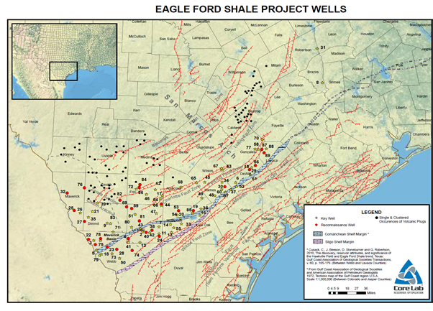
Overview of THE PROJECT
Challenges
Increasing demands for better technologies for unconventional E&P: where to drill and how to complete , e.g., sweet spotting, well landing, fracturing, proppant parameters, …
Data Analytics/Machine Learning has big potentials for E&P
Machine Learning is good for tough problems
Kaggle’s study provided a good starting base
Business Impact
Build in-house capability instead of using vendors’
black-box pay per play service;
Reduce E&P cost & faster, better business decisions
Deliverables, Partners, Targeted Use Cases
Software Implementation & know-how documents of methodology & workflow
Internal & External Partners: PTI/UU (C. Hackbarth), PTW (L. Stockwell), PTD/TASE (P. Johnathan), UAU/Y/T (D. Langille), UCL, IBM Research, MIT CSAIL.
Targeted Use Cases: Appalachia, Permian, etc.

Slide 5
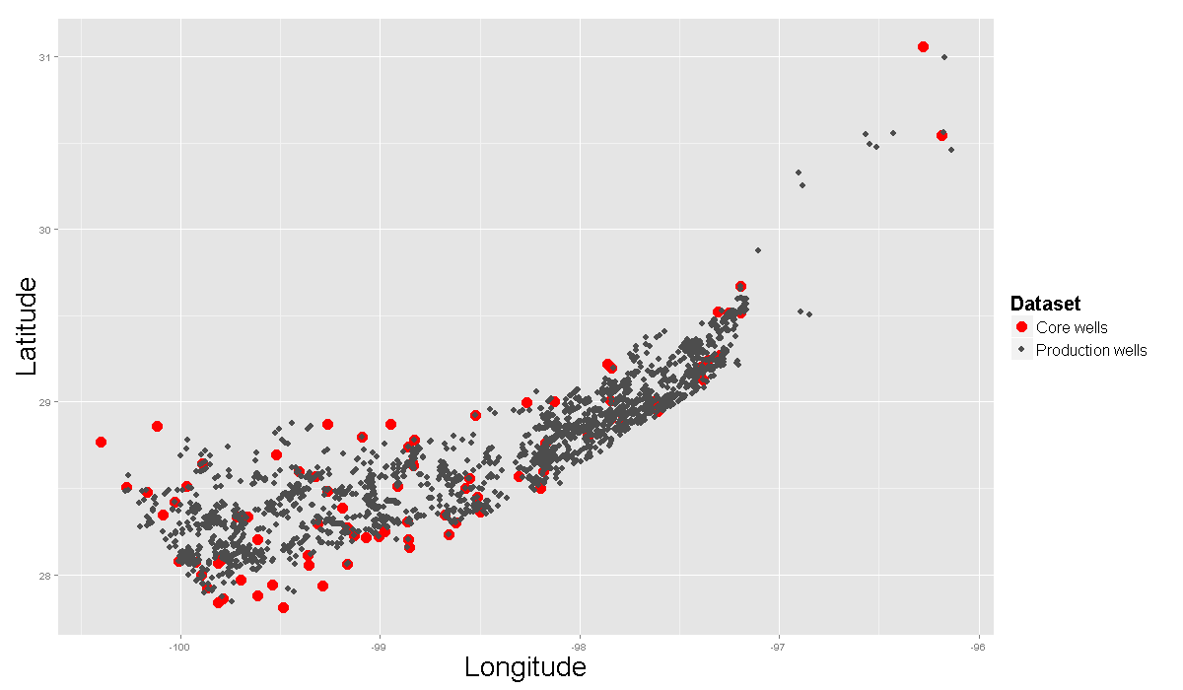
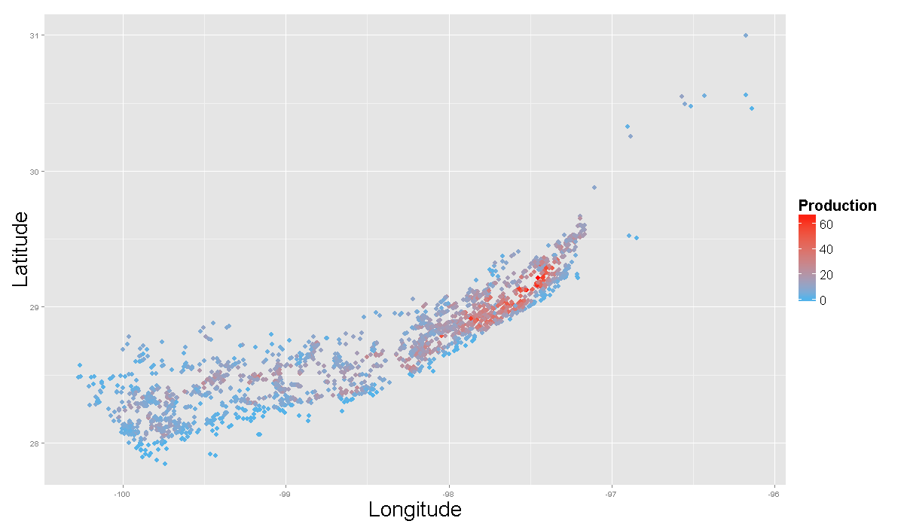
OVERVIEW OF EAGLE FORD DATA
2631 oil production wells
81 cored wells
Oil production & cored wells distribution
Production Heat Map

Slide 6
OVERVIEW of WORKFLOW and METHODOLOGY
Raw Data
Data Integration
Preprocessing/
Outlier Removal
Interpolation
Interpolated Feature Map
Stratigraphy Aggregate
Geological Feature Interpolated Map
Engineering Parameters
Predictive Modeling/ Prediction
Core Analysis Data
Predictive Modeling
1st 12-mo. Production
Well Logs
Normalized 1st 12-Month Production
Predictive Model

Slide 7
2.0
Data integration and interpolation

Slide 8
CoreWells vs. IHS Wells - 2D Map
Notes:
We are currently in Phase 2 of the project in which we try to tackle the problem of integrating the spatially sparse but information (in terms of geological information) rich CoreLabs data set (black dots) with the dense production data set from IHS (red dots). In the following I will talk about the challenges of integrating the data sets, our algorithmic approaches and preliminary results (as far as they are meaningful without considering the total context of the prediction problem).

Slide 9
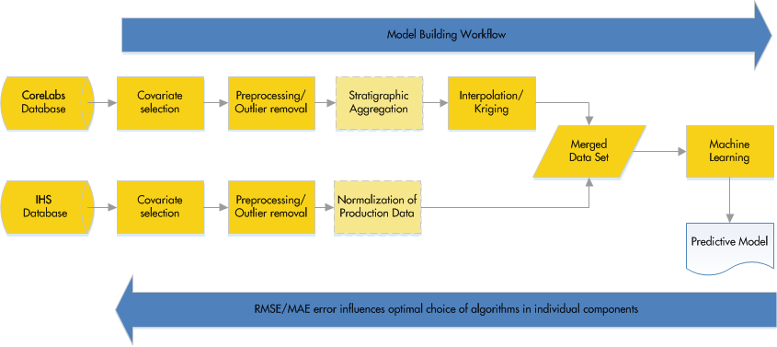
Main Data Processing steps
Notes:
Explain the context and set the stage for the steps that are necessary to spatially integrate the CoreLabs and IHS data sets:
At this stage we have a complete prototype implementation of the complete work flow.
Some components like preprocessing and aggregation only use basic methods at the moment and may potentially be improved in the future.
Aggregation and Interpolation/Kriging are studied in the current phase of the project in detail. Since we also investigate different combinations in detail we will hence be able to determine a possibly good combination of methods, which also sets us apart from previous attempts.
The components in the lighter colour are optional, depending on how we address the problems.

Slide 10
Individual Components
Covariate Selection:
Big Rules/Kaggle
Discussion with domain experts
Availability of data per well/ Basic statistical analysis
Out of sample interpolation/prediction error
Preprocessing:
Removal of redundant/linearly dependent data
Conventional outlier removal
Data transformations (e.g. log transform, Box–Cox transformation, …)
Notes:
Covariate Selection:
Covariate selection is an important step since most algorithms tend to overfit if too much data is provided to them and the OOS validation error increases. Quite naturally data driven methods are sensitive to the quality of the data that you provide to them hence you want to have a good idea of what drivers you have in your physical system.
Our initial covariate selection was derived by discussion with domain experts and prior work like the Big Rules and also the analysis done by Kaggle
Additionally we also took more covariates onboard in some of our test set-ups.
Since the availability of certain data types varies quite significantly between wells this also factors into the decision.
The ultimate way to determine the impact of a covariate is to judge the OOS validation error in the model with and without the variable. But this is not totally trivial because of the interpolation step in between. This also be automated to a certain extent unlike the other steps.
Preprocessing:
For pure prediction purposes linear dependencies in the input data do not play such an important role. However, when they are left in it becomes normally very hard to make reliable sensitivity studies of the input parameters. We have automated this step.
Conventional outlier removal is still necessary and some human judgment is necessary in this process. (Would be good to have pre-cleaned data from one of the Shell data bases that was mentioned in one of the earlier discussions)
Non-linear data transformations are in general applied to make the data sets more normally distributed. For instance permeabilities tend to be log normally distributed. A lot of algorithms work better if the underlying data tends to be normally distributed.

Slide 11
Individual Components
Stratigraphic Aggregation:
Per zone mean/median/…
Could be skipped if 3D models are used
Normalization of production data:
By lateral length/other depth related normalizations
Potentially later and more advanced: singular scores
Interpolation/Kriging:
Mean functions like zero, const, linear
Matérn type kernels (i.e. Gaussian, Laplace)
Automatically and manually fitted variogram models for kriging
Potentially later: Co-Kriging, …
Notes:
Stratigraphic Aggregation:
Since we are currently only looking at 2D models we only consider aggregates like man/median of the covariates in the actual pay zone.
Normalization of production data:
It should be noted that the ideal prediction outcome, i.e. the choice of „normaliazion“ of production, has not been established yet. Since it cannot be estabilshed by the data alone some more discussions with experts will be necessary to asses the practical value and interpretability of certain normalizations. For instance division by lateral length seems natural for horizontal wells.
Interpolation/Kriging:
Kernel ridge regression = Gaussian process interpolation = Kriging upto the choice of parameters
kernels = covariance functions and correspond to a choice of variogram type
Automated parameter tuning for kernel methods can be achieved using cross validation results in a relatively cheap way.
There are potentially a lot more methods to investiagte but eventually time will be a limiting factor.

Slide 12
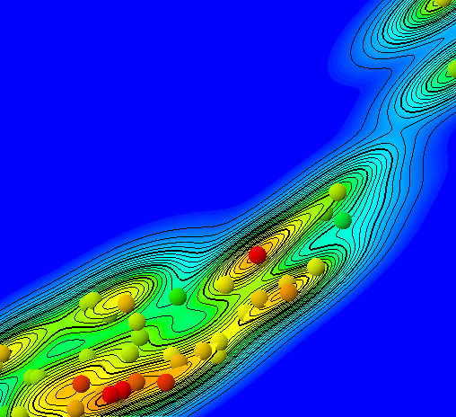
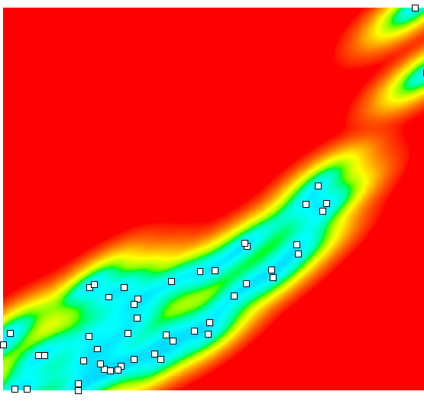
Manual Variogram Modelling and Kriging
Leveraging knowledge from domain experts if available:
Manual variogram modelling with input from geostatistics SME
Example – Total organic content
Estimated variance map
Kriged data
Uncertainty ranges
Notes:
In our workflow we allow to leverage expert knowledge by also optionally including manually fitted variogram models.
First picture shows the variance for TOC. Using that information an anisotropic gaussian variogram model was fitted.
Second picture shows the kriged TOC on the original map.
The third picture shows the uncertainty ranges.

Slide 13
Automated Variogram Modelling
Using out of sample (OOS) validation we can determine efficiently the nearly optimal parameters of a given variogram model
Advantages:
No human interaction required
Applicable to 100s of covariates
Allows ranking of covariates for further modelling steps
Potential issues:
Danger to get stuck in a local minimum if many parameters have to be determined
2
0
40000
80000
120000
160000
200000
240000
280000
320000
360000
400000
2
1.9
1.9
1.8
1.8
1.7
1.7
1.6
1.6
1.5
1.5
1.4
1.4
1.3
1.3
1.2
1.2
1.1
1.1
Semivariance
1
1
0.9
0.9
0.8
0.8
0.7
0.7
0.6
0.6
0.5
0.5
0.4
0.4
0.3
0.3
0.2
0.2
0.1
0
40000
80000
120000
160000
200000
240000
280000
320000
360000
400000
0.1
Separation distance
Symbol legend
Sample var. from PointsWithAttributes.txt (Leco TOC (wt percent)) (55 deg)
Variogram

Slide 14
Manual vs. Automated Parameter Estimation
Findings:
Automated parameter selection for Kernel functions yields good results in terms of OOS validation error (e.g. compared to guessing the mean)
Manually fitted models are still slightly superior if they take anisotropy into account
Gap can be closed if a reasonable initial “guesstimate” for the anisotropy is provided to the automated procedure
Our own integrated data set is at least as good as Kaggle’s in terms of OOS validation error of the production predictions
Optimal combination of methods still needs to be determined by evaluating more combinations of techniques in the total workflow
Notes:
There are quite a few different ways in how the parameters can be fit. Some require the computation of an experimental variogram first which introduces additional binning parameters. Maximum likelihood techniques don’t require that. An exhaustive search is in general too expensive. But the results that we have obtained so far are competive with Kaggle’s data set.

Slide 15
3.0
Predictive modeling

Slide 16
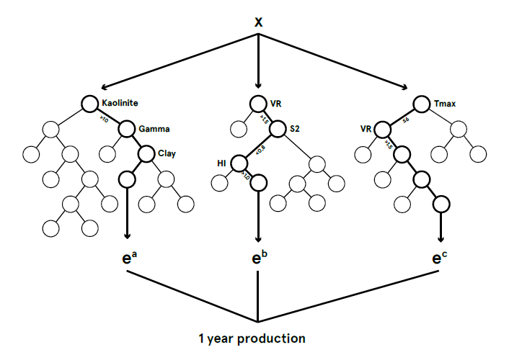
RANDOM FOREST ALGORITHM
Decision trees
Random Forest (ensemble decision trees)
Non-parametric method without any distribution assumptions on x and y
Can handle nonlinear relationships
Provides effective methods for estimating missing data ...
X₁
X₁ < t₁
X₁ ≥ t₁
X₂
X₃
X₂ < t₂
X₂ ≥ t₂
X₃ < t₃
X₃ ≥ t₃
X₄
C₃
C₄
C₅
X₄ < t₄
X₄ ≥ t₄
C₁
C₂
5/18/2015
16

Slide 17
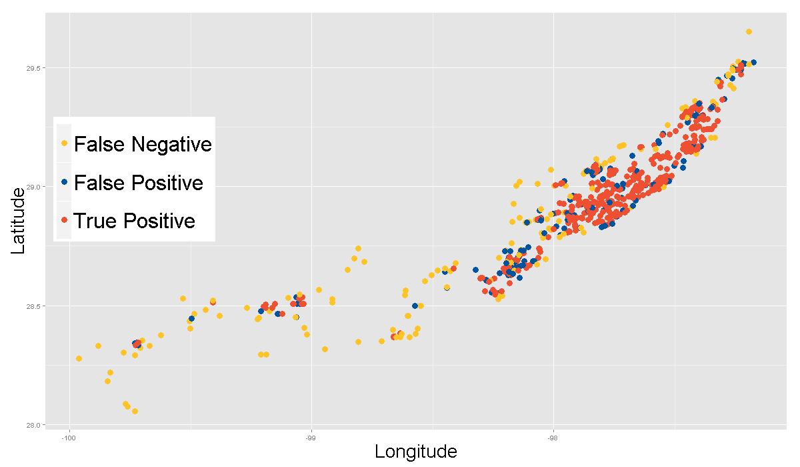
RESULTS (RF 5-Fold Cross-Validation)
Eagle Ford Oil Producer Sweetspots (658 out of 2631)
Top 25% Wells True Production
Top 25% Wells Predicted
Correctly Identified TQ
Random Draw | Rule Based | Kaggle | RF
165 | 201 | 366 | 484
74% Overlap
5/18/2015
17

Slide 18
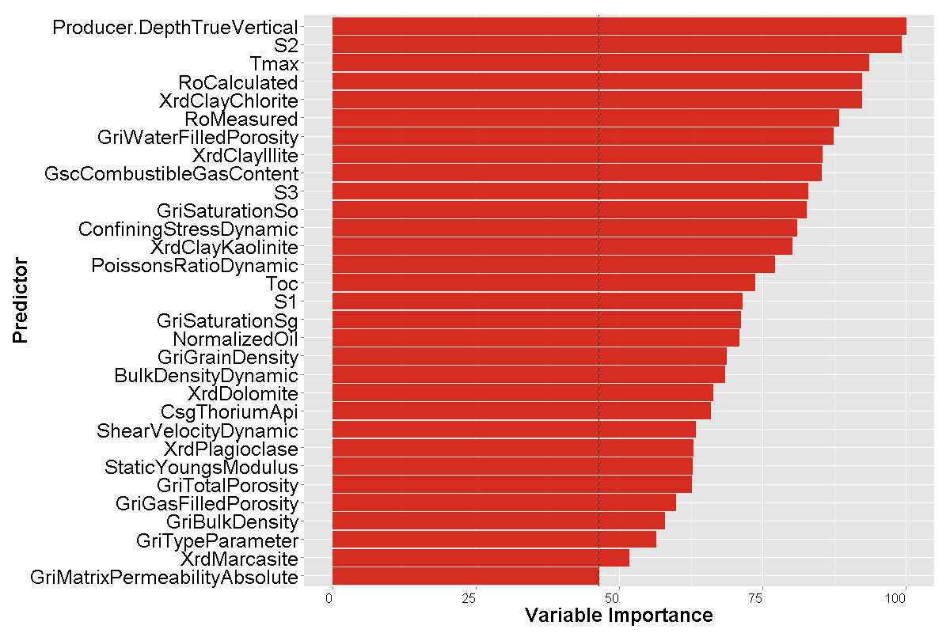
VARIABLE IMPORTANCE
Permutation-based MSE reduction measure normalized by the maximum score.
5/18/2015
18

Slide 19
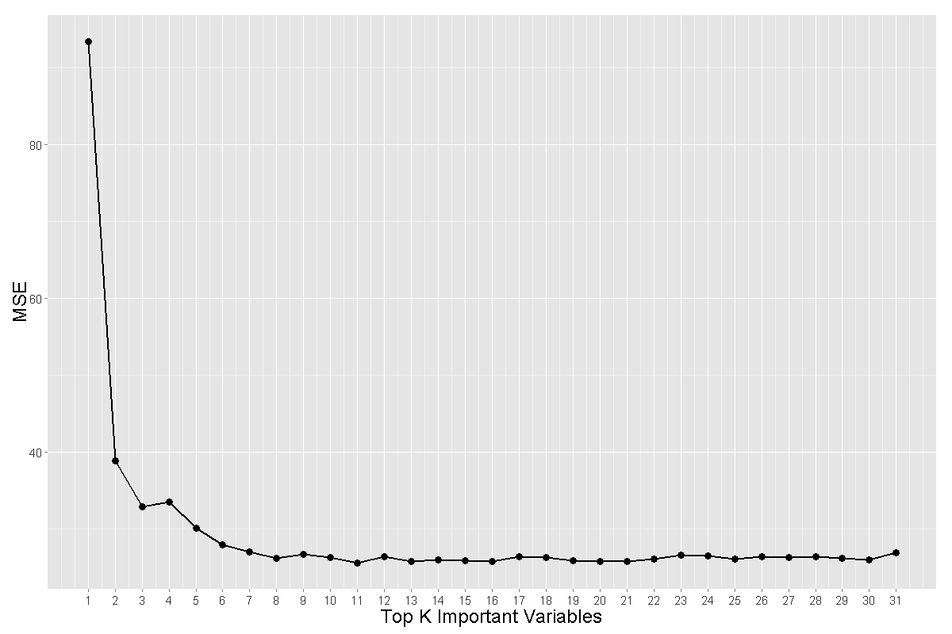
PREDICTION BASED ON TOP K IMPORTANT VARS
Results of 5-fold cross-validation
Top 7 important vars. are good enough to build a predictive model.
Correlation Tmax and Ro Calculated ~ 1, Ro Calculated is removed from the model.
A parsimonious model (6 vars.) achieved similar performance as full model (31 vars.)
{True vertical depth, S2, Tmax, Chlorite in clay(X-ray diffraction), Ro measured, GRI water filled porosity}
5/18/2015
19

Slide 20
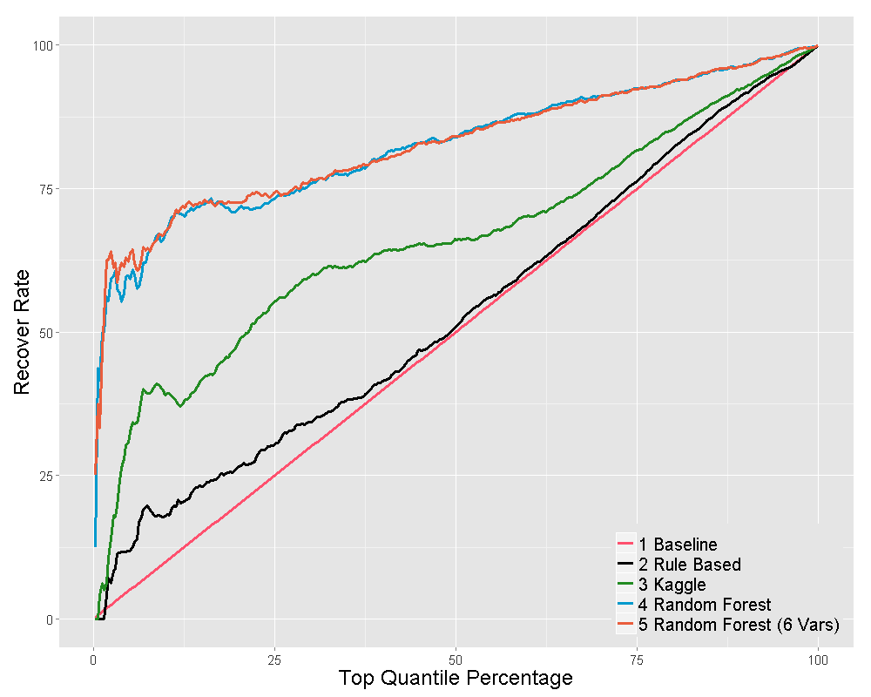
TOP QUANTILE RECOVERY CURVE
Performance Comparison of Different Models
Results of 5-fold Cross-validation
5/18/2015
20

Slide 21
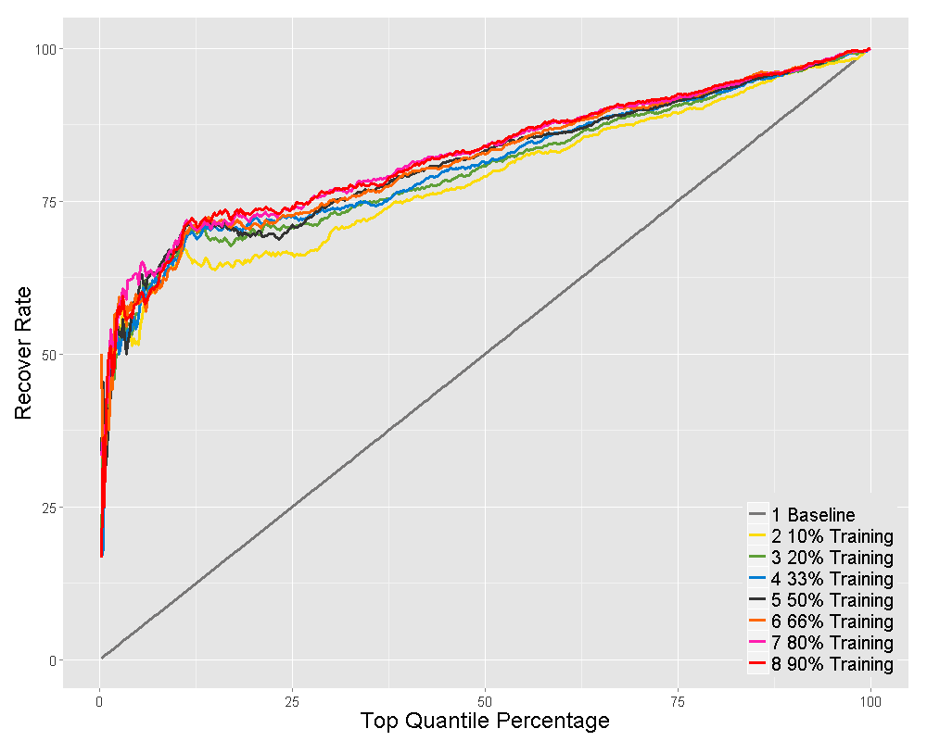
TOP QUANTILE RECOVERY CURVE (6 VARS MODEL)
Performance Comparison of Different Training Percentage
Results of Cross-validation
5/18/2015
21

Slide 22
4.0
FUTURE WORK

Slide 23
Going Forward
Improve the workflow: flexible standardized interfaces; Additional algorithms (anisotropic variogram modeling & co-kriging) and variants; Test feasible combinations and assess their impacts
Continue to work with our partners to address how to drill & complete wells by including drilling and completion parameters into our workflow
Two agreed collaboration projects w/ PTW: Ayata (Permain) and well landing (Appalachia) to identify the key drilling and completion issues and parameters for Appalachia and Permian data sets; Another w. IBM in contracting; Q3-Q4, 2015.
ML/DA modeling and prediction results in Q4 2015.
Apply to active assets E&P in 2016 and beyond.
Potential Values
Provide superior guiding technology for new well drilling and completion to reduce cost and improve production.
Furnish quick and better methodology for new asset assessment.
Serve as a proven case for Shell’s big data analytics strategies ( see White Paper).

Slide 24


Slide 25
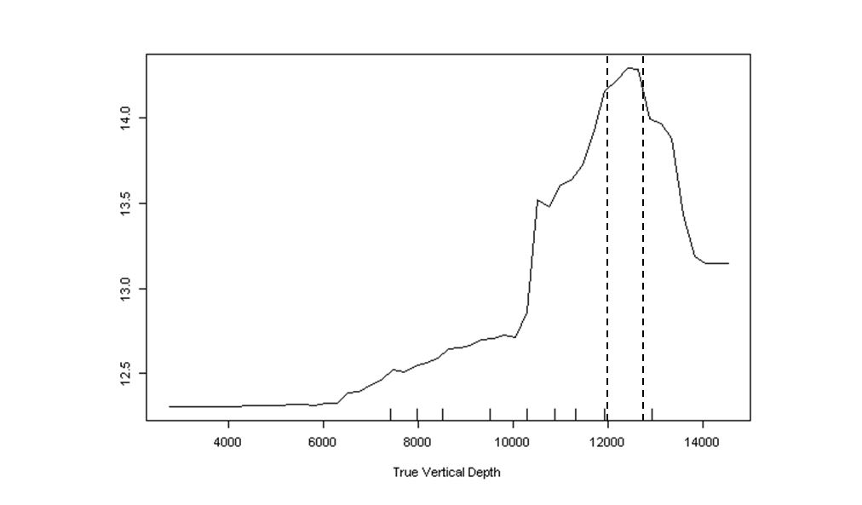
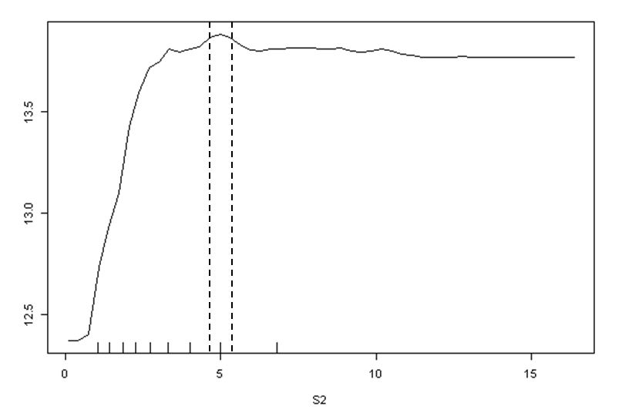
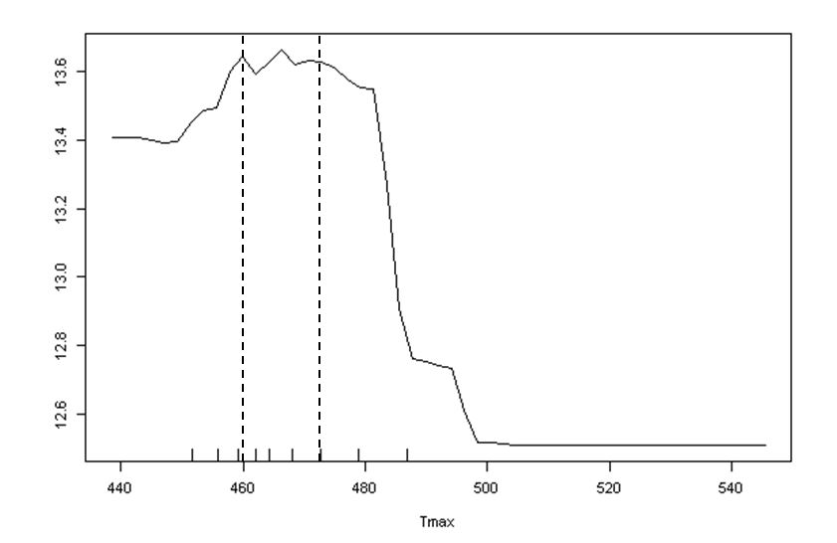
PARTIAL DEPENDENCE PLOTS
Peak production is achieved at certain range of each predictor
TVD ~ (12000, 12800)
Tmax ~ (460, 472)
S2 ~ 5
5/18/2015
25

Slide 26
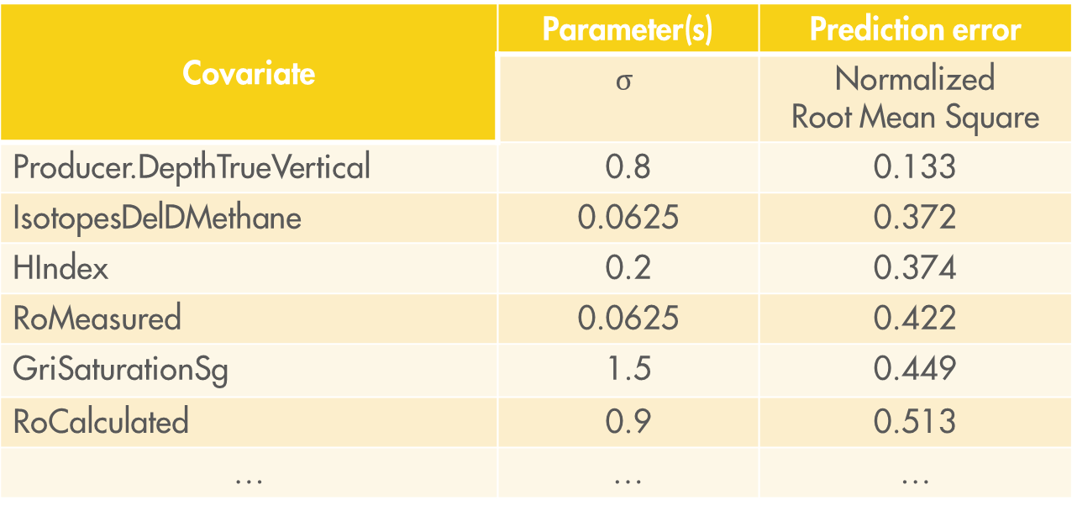
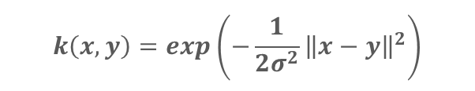
Automated parameter fitting – Kernel Regression
$$k\left(x,y\right)=exp\left(−\frac{1}{2σ^{2}}{\left\|x−y\right\|}^{2}\right)$$
Example Gaussian Kernel:
Covariates and out of sample prediction error
Covariate | Parameter(s) | Prediction error
 | $$σ$$ | Normalized Root Mean Square
Producer.DepthTrueVertical | 0.8 | 0.133
IsotopesDelDMethane | 0.0625 | 0.372
HIndex | 0.2 | 0.374
RoMeasured | 0.0625 | 0.422
GriSaturationSg | 1.5 | 0.449
RoCalculated | 0.9 | 0.513
… | … | …
Notes:
This tables shows the chosen covariates and their normalized OOS validation error for kernel ridge regression with a Gaussian kernel. Note that a good OOS value here does not mean that the covariate is in fact predictive. It only means that it can be interpolated well. A value of 0 is ideal and 1 is the worst possible value since we are talking about normalized values.
Sigma is a parameter of the Gauss kernel (closely related to Variogram models) that we used to interpolate the covariates.
The table is not complete at the moment since we are only looking at 31 covariates as input.
Note that RoCalculated is in fact derived directly from Tmax (linear relationship)
Producer.DepthTrueVertical = Vertical depth of well
IsotopesDelDMethane = Fractional precentage of Methane that contains the Hydrogen isotope Deuterium
HIndex = S2/TOC*100 (mg/g TOC)/ Depends on maturity and kerogen composition/ S2 derived from Pyrolysis Analysis - provides the quantity of hydrocarbons that the rock has the potential to produce through diagenesis
RoMeasured = Measured permeability
RoCalculated = Computed via corellation in TMax

